Slide 1
A Gentle Intro to Exploits and Shellcode
DEFCON813 – February 2017

Slide 2
Constraints
There are many rabbit holes ahead. Some may appear very tempting … but there simply is not the time. If you see a really neat rabbit hole, make a note for yourself and propose it for a future session.
Unlikely everyone here arrived ready to rock out with Python, assembly, Windows and Linux debugger skills, etc. That’s a good thing because if you were you’d probably be making inefficient use of your time. Follow along, we will do practical exercises as we go, if you get lost along the way you will have materials and resources to revisit on your own schedule.

Slide 3
Requirements
Kali 32-bit (virtual machine preferred)
Windows XP/7/8/10 (virtual machine preferred)
The Kali and Windows machines need to be able to talk to each other over a network interface (hopefully a virtual/local interface!)

Slide 4
Software
Immunity Debugger (preferred) or OllyDbg
Vulnserver
Time and interest permitting some real-world vulnerable applications

Slide 5
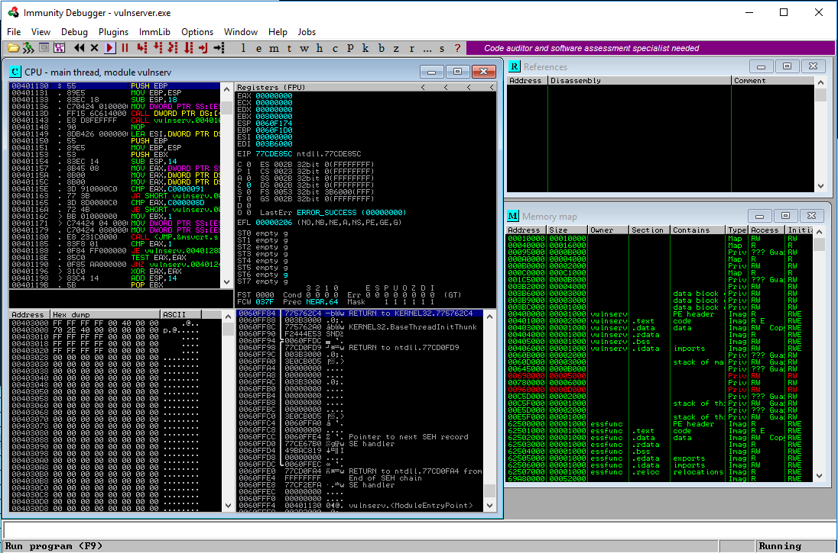
Windows Debugger: Immunity

Slide 6
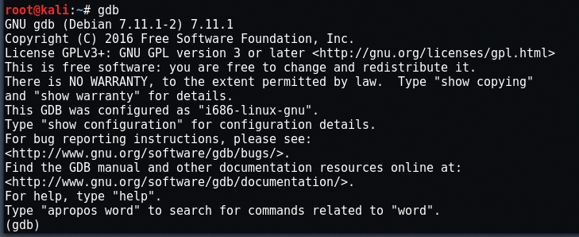
Linux Debugger: gdb
GNU Debugger
https://www.gnu.org/software/gdb/documentation/

Slide 7
Exploits: Memory Corruption Family
Not all exploits involve memory corruption but today we will focus on this family of bugs/exploits and buffer/stack overflows in particular
Root cause is unchecked bounds, taking a provided input solely upon trust and inserting that input into memory. If that input is larger than the programmer & compiler expected it could end up overwriting memory being used for other purposes.

Slide 8

Windows Exploits and Shellcode

Slide 9
vulnserver.exe
Project created by Stephen Bradshaw as a learning tool for fuzzing, exploit discovery, adding shellcode, and overcoming some of the common challenges in exploit development.
Run the vulnserver.exe on a Windows machine that is not exposed to the Internet or a network. It contains multiple remote code execution vulnerabilities.
When running it will operate as a server listening on port tcp/9999. Connect to it from the Kali machine via netcat and explore its functionality.
http://www.thegreycorner.com/p/vulnserver.html
Notes:
Stephen Bradshaw’s blog: http://grey-corner.blogspot.com/
Stephen Bradshaw’s webpage for vulnserver.exe: http://www.thegreycorner.com/p/vulnserver.html

Slide 10
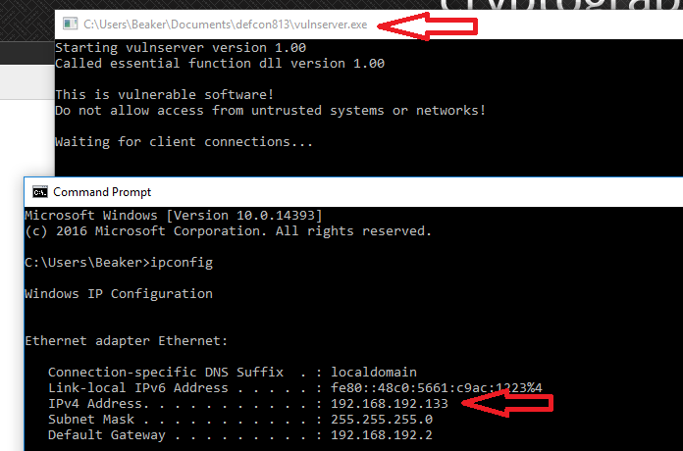
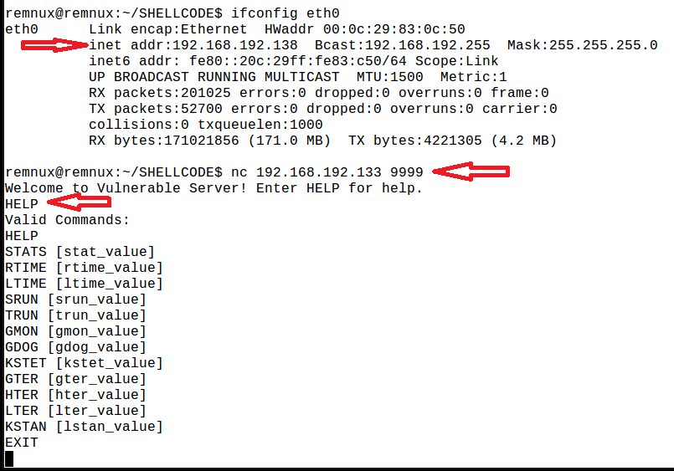
vulnserver.exe
Verified the vulnserver.exe is running properly and we can connect from our Linux machine

Slide 11
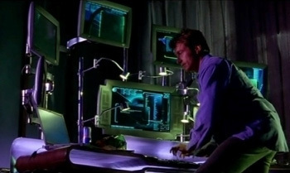
<montage>
We are going to skip over the fuzzing, identification of the vulnerable code path, and jump to the point right where we’ve found the precise buffer length to achieve control of the instruction pointer. Imagine a bad Hollywood hacker montage.

Slide 12
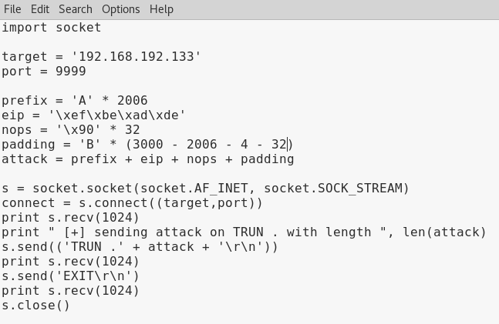
</montage>
Vulnerable code path selected: TRUN
Size of buffer to reach EIP corruption: 2006 bytes

Slide 13
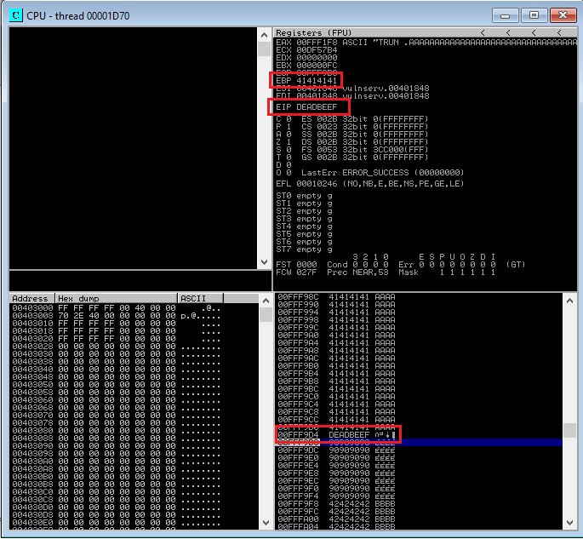
In Debugger …
Note EIP and EBP register values we have control over (top right window)
Also note the values on the stack before and after the EIP value of ‘DEADBEEF’ (bottom right window)

Slide 14
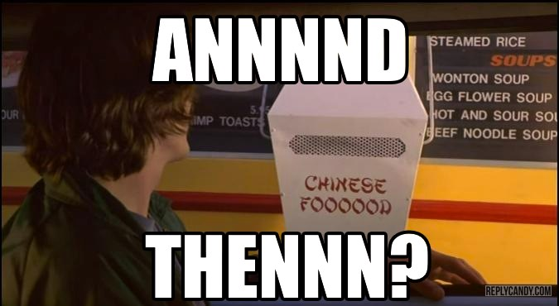
Congrats! You Can Insert 4 Bytes into EIP …

Slide 15
… And Then We Complete the Order
Coerce EIP to point to an address we control and can insert valid machine code instructions for it to execute
We will skip the finer details here but we control EIP and EBP so we find a static address with JMP EBP

Slide 16
Shellcode
Definition: a shellcode is a small piece of code used as the payload in the exploitation of a software vulnerability. It is called "shellcode" because it typically starts a command shell from which the attacker can control the compromised machine, but any piece of code that performs a similar task can be called shellcode. Because the function of a payload is not limited to merely spawning a shell, some have suggested that the name shellcode is insufficient.
Notes:
https://en.wikipedia.org/wiki/Shellcode
Some random shellcode repo’s to get started:
http://shell-storm.org/shellcode/
https://www.exploit-db.com/shellcode/

Slide 17
Not Regular Code
Not like a compiled program … but you can compile a program and extract parts of the resulting machine code to serve as shellcode
Shellcode often has to avoid “bad characters”
And is often obfuscated/encoded to avoid detection by IDS, HIDS, AV in addition to encoding performed to avoid bad characters

Slide 18
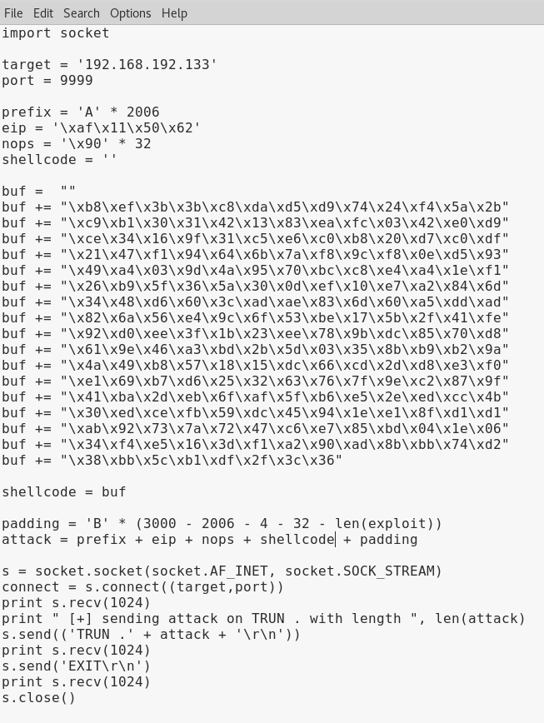
Finished Exploit + Shellcode
Vulnerable code path selected: TRUN
Size of buffer to reach EIP corruption: 2006 bytes
EIP redirection via JMP ESP opcodes found at 0x625011af of essfunc.dll
Shellcode in buf/shellcode

Slide 19
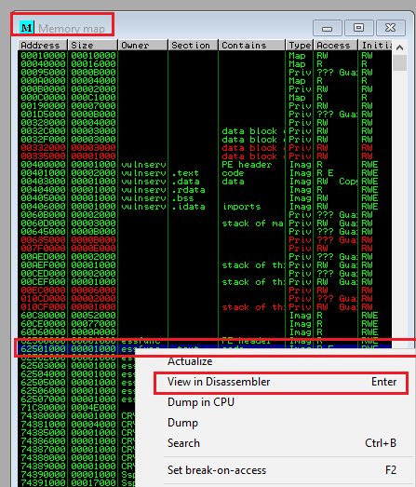
Set Breakpoint To Watch Shellcode Execute
From Immunity Debugger use the ‘Memory Map’ window, find the .text section of essfunc, right click and ‘View in Disassembler’

Slide 20
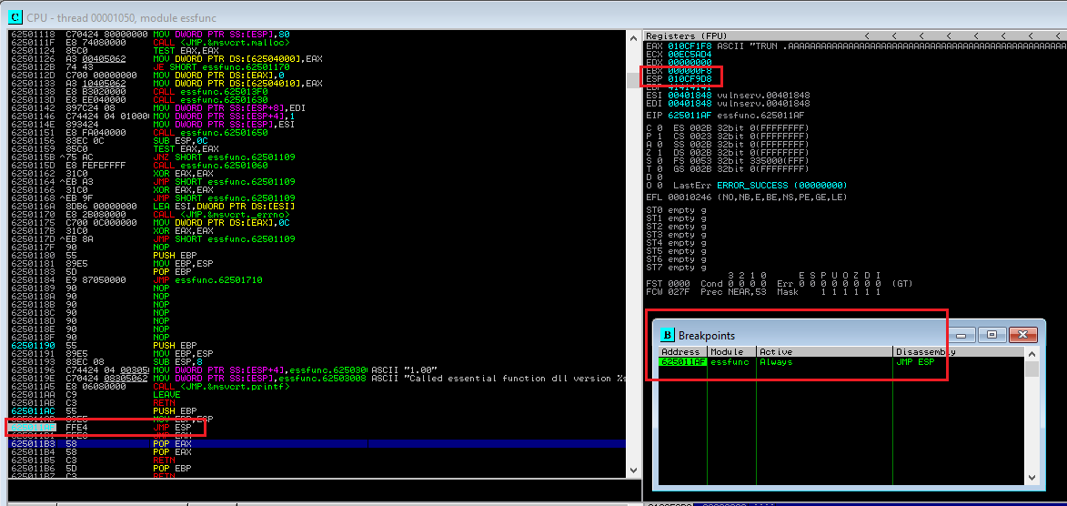
Set Breakpoint at 0x625011af inside essfunc

Slide 21
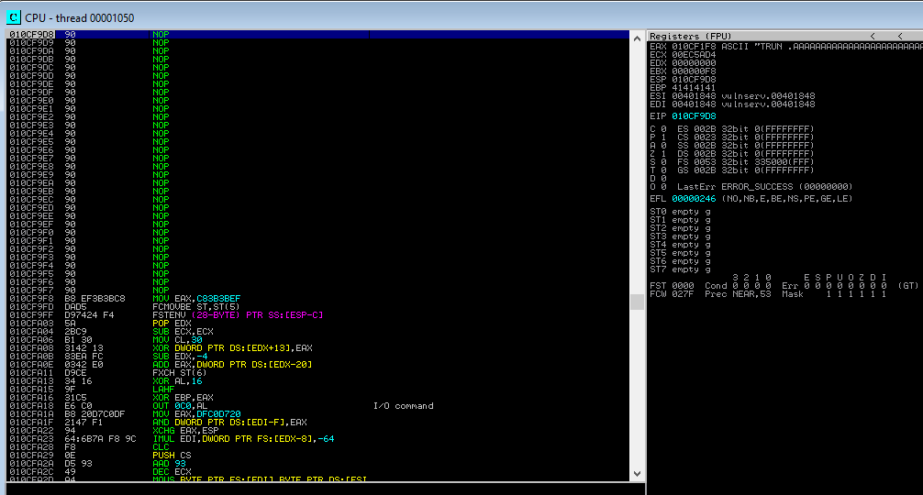
Step Through the Shellcode (f7)

Slide 22
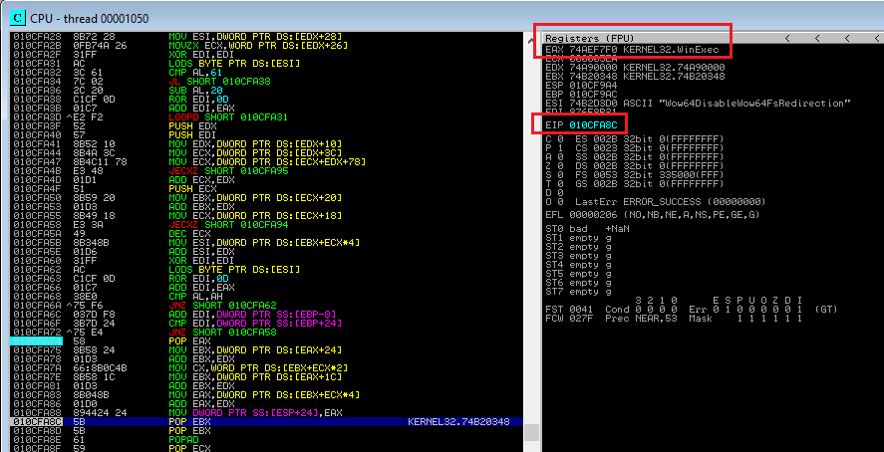
(it’s encoded … so it’s painful … but …)

Slide 23
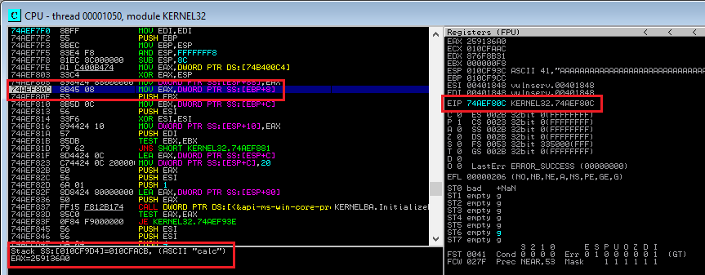
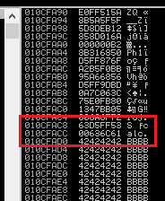
…. About to fire off call to kernel32.WinExec

Slide 24
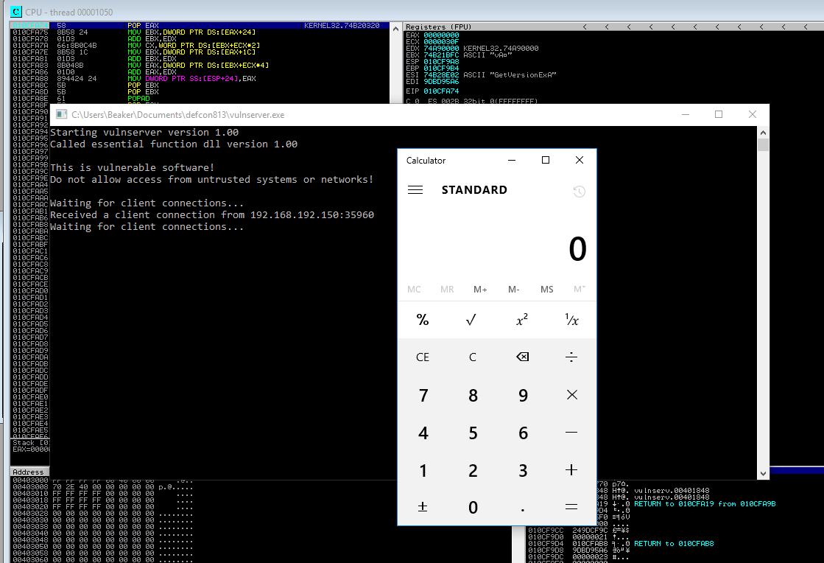
… and finally …

Slide 25


Linux Exploits & Shellcode

Slide 26
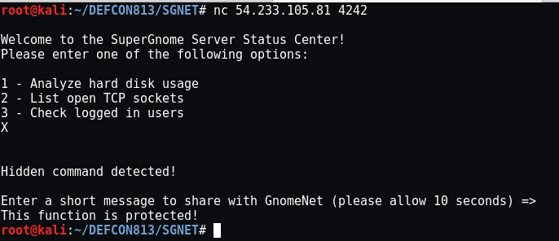

Holiday Hack Challenge 2015
https://www.holidayhackchallenge.com/2015/
SG-5 flag required creating a remote code execution exploit against a Linux server bypassing two exploit mitigations (ASLR and an unusual stack canary)

Slide 27
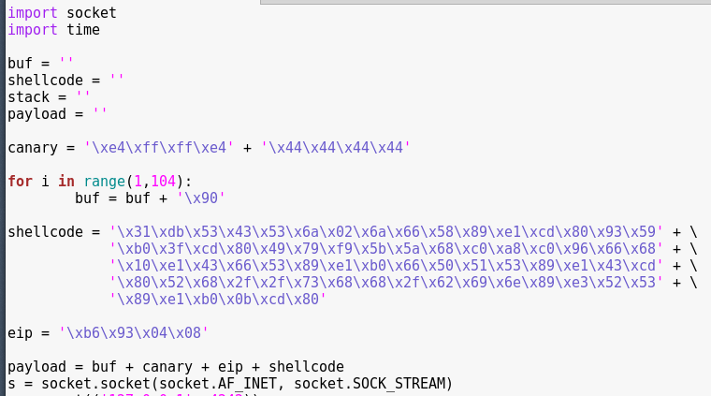
SGNET: Reversing the Shellcode
Start with the easiest form: shellcode divisible from the buffer overflow. Our Python exploit code

Slide 28
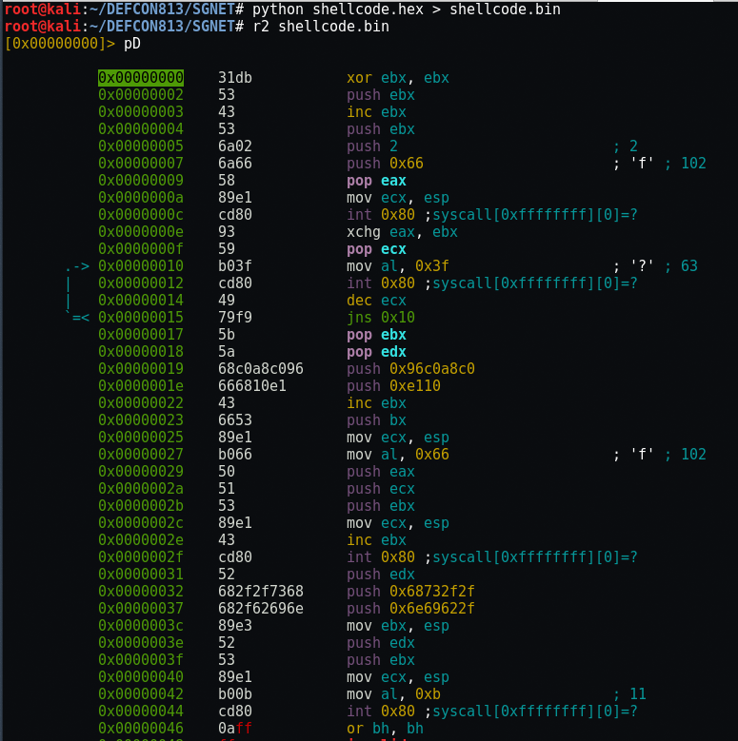
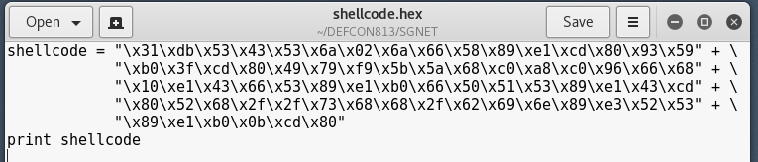
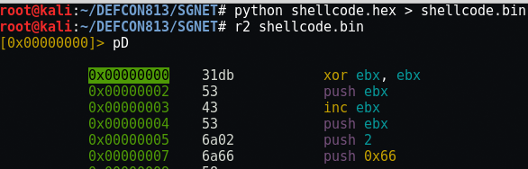
radare2 Direct Disassembly
r2 can directly disassemble shellcode. Copy and paste the shellcode segment from the prior Python program and have Python ‘print’ the binary, redirecting the binary into a file

Slide 29
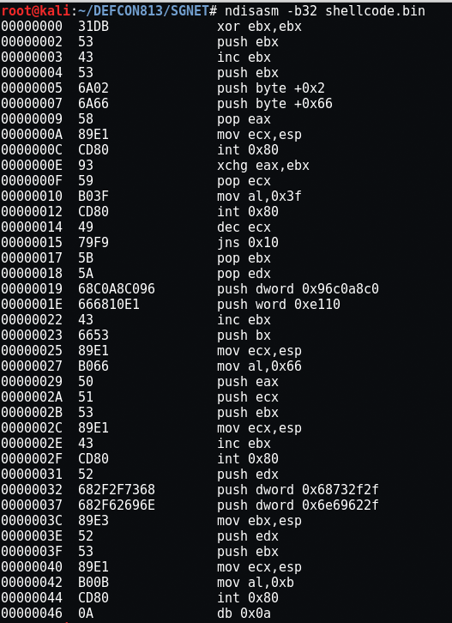
ndisasm Direct Disassembly
Netwide Disassembler, ndisasm, can also provide a direct disassembled dump of shellcode. Just with less features.

Slide 30
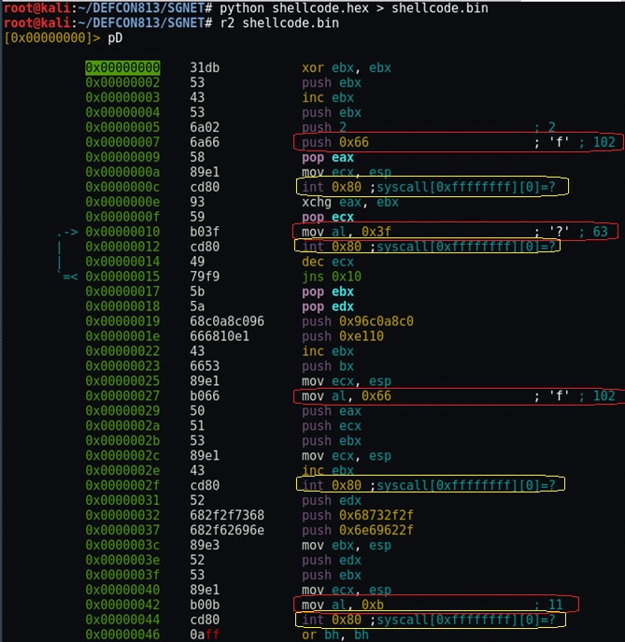
Zero in on “int 0x80’ syscall instructions and the numeric values ‘push’ed immediately prior to them:
102
63
102
11
Notes:
Tutorial on Linux syscalls usage in Assembly: http://asm.sourceforge.net/articles/linasm.html#Syscalls

Slide 31
int80 / syscalls?
An operating system request made by an interrupt (int80) by an active process for a service to be performed by the kernel
http://syscalls.kernelgrok.com/
102 = sys_socketcall (bind to socket)
63 = sys_dup2 (duplicate socket stream for I/O redirection)
102 = sys_socketcall (socket call with IP & port #)
11 = sys_execve (execute a program: /bin/sh)

Slide 32
Could you modify this shellcode in hex?
Reverse shell IP address?
Port number it calls back to?
The O/S command it executes?
The syscall reference? (this one gets tricky to change up on the fly)

Slide 33
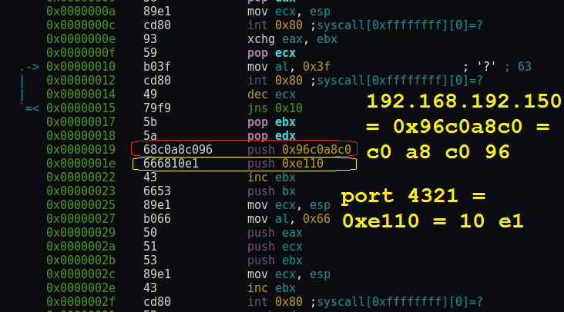
Where is our IP address and port?

Slide 34
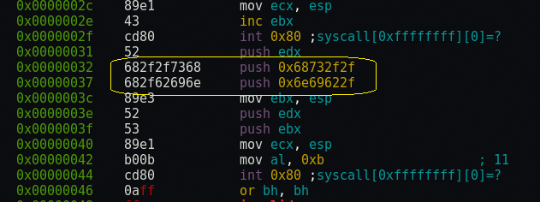
Where is our O/S command being called?
0x68732f2f = 2f 2f 73 68 = / / s h
0x6e69622f = 2f 62 69 6e = / b i n

Slide 35
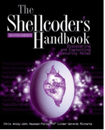
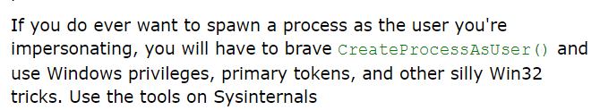
Linux vs Windows Shellcode
No surprise that the O/S’s functioning underneath the hood differs:
Linux has system calls. Push values onto a stack, syscall(), done.
Windows has pointers to addresses of system library functions. Addresses that change and you have to go hunting for them. Fun?
Windows shellcode is typically larger and harder to do than a Linux equivalent. Guidance from ‘The Shellcoder’s Handbook’:

Slide 36
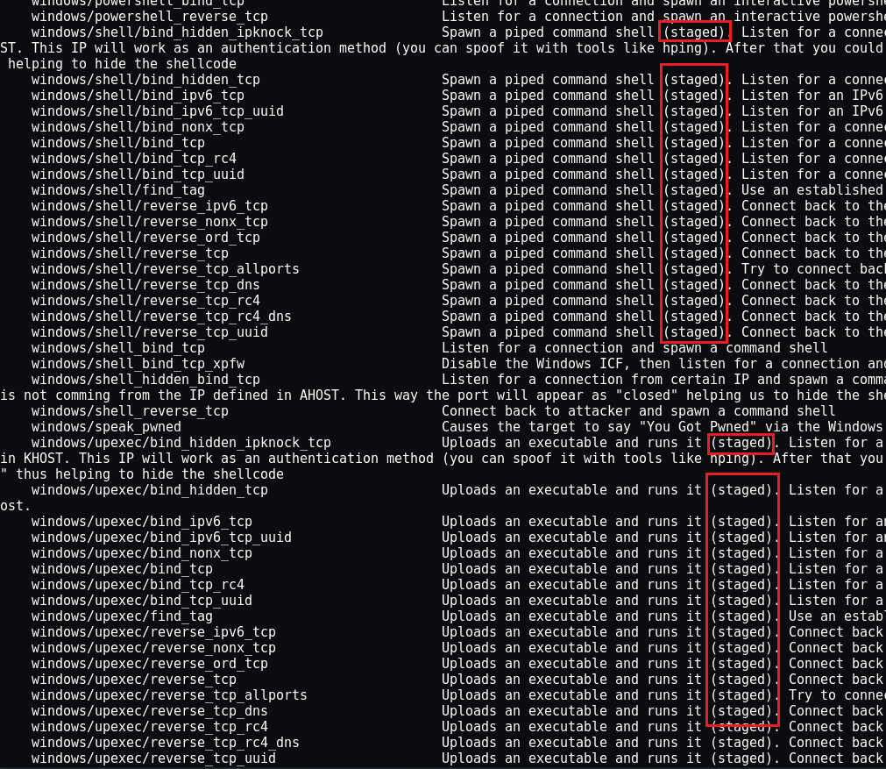
Shellcoding to Windows
Send a DLL over to the exploited process and link it (DLL injection)
Dynamic shellcoding: seeks to overcome the addressing challenge by dynamically locating the desired function addresses and use those addresses in the main shellcode for execution
Many of the Metasploit Windows payloads are staged. A simple ‘reverse shell’ is not quite so simple under Windows.

Slide 37
Where can I find shellcode?
Generally reliable:
exploit-db.com
shell-storm.org/shellcode/
Feeling lucky? … if you enjoy reverse engineering to verify:
Rumors of a new 0-day (ShadowBrokers) and code is posted
Web forums
Best place to start:
Metasploit

Slide 38
msfvenom: Your Shellcode Best Friend
Metasploit’s standalone payload generator; all those payloads you recall from using Metasploit’s msfconsole can be directly output in a wide variety of formats. We will stick with Python today.
To output a Linux x86 reverse shell and we want to check the options available:
Notes:
https://www.offensive-security.com/metasploit-unleashed/msfvenom/

Slide 39
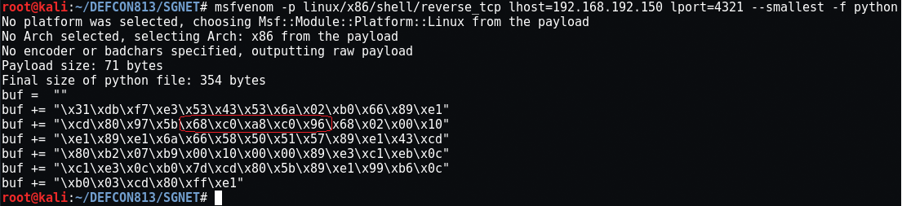
msfvenon: Linux Reverse Shell
Can you see our IP address and port number in this code which is ready to paste into a Python script?

Slide 40
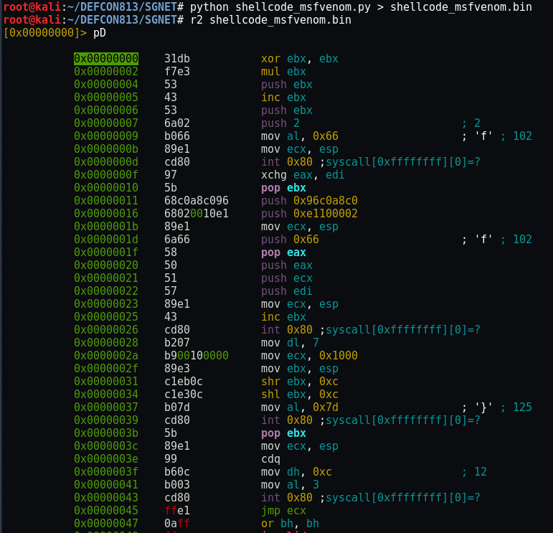
Slightly Different?

Slide 41
Simple Examples Completed So Now …
Shall we go ankle deep now?
Visit www.exploit-db.com and let’s explore some sample shellcode
www.exploit-db.com/exploits/13571
“Win32/XP SP2 – calc.exe Shellcode (45 bytes)”

Slide 42
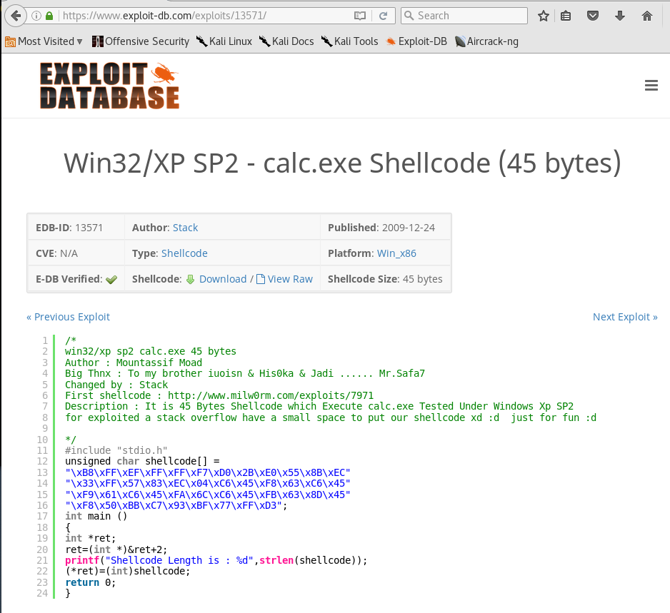
Exemplar shellcode is written in which language?
Any particular reason why?
Date?
Architecture?
How could we verify what it does?

Slide 43
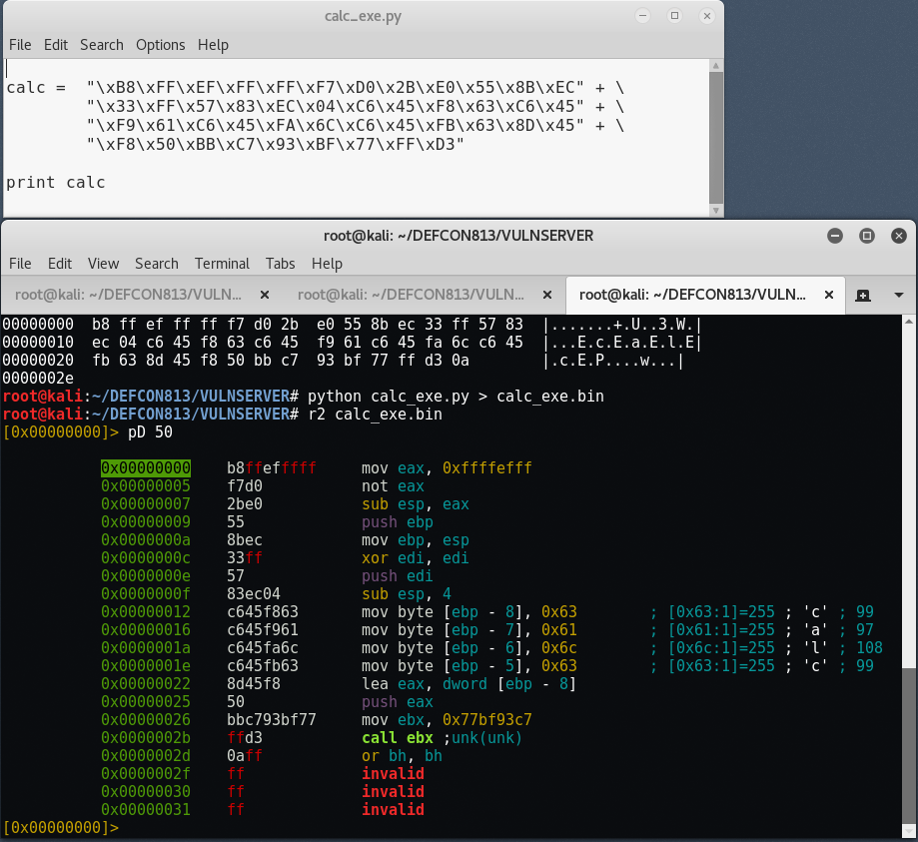
One path …
Prefer Python? No problem.
Confirm the Python output matches the shellcode input (sort of … what happened? Does it matter?)
Disassemble the shellcode with radare2

Slide 44
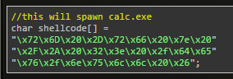
Oh, found shorter shellcode from Corelan!
That’s much tighter shellcode! And it was posted on Corelan’s website so it’s got to be good …

Slide 45
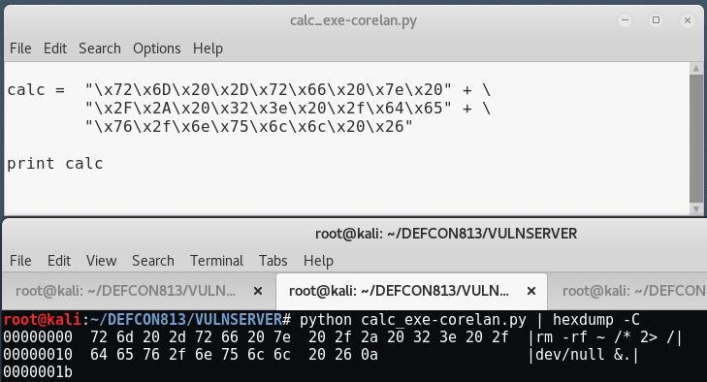
Son of a … !
https://www.corelan.be/index.php/2010/02/25/exploit-writing-tutorial-part-9-introduction-to-win32-shellcoding/

Slide 46
End of The Gentle Intro …
Do we think we can answer: “How do I verify what it is that shellcode does?”
Do you even need to? Remove the unknown shellcode and use some from a trusted source instead.
Verification is effectively the same thing as malware reverse engineering: static and dynamic analysis of (usually obfuscated) code
Can we repurpose an exploit or shellcode found in code or in a packet capture?

Slide 47
Generic Stack Overflow Completed! But …
Aren’t there exploit mitigations?
Stack Canaries / Security Cookies / Buffer security check (the ‘/gs’ compile flag)
SafeSEH: Safe Structured Exception Handlers and SEHOP: Structured Exception Handler Overwrite Protection
DEP: Data Execution Prevention (NX/No-Execute)
ASLR: Address Space Layout Randomization
CFG: Control Flow Guard
Notes:
MSDN /GS Buffer Security Check: https://msdn.microsoft.com/en-us/library/8dbf701c.aspx
TechNet Article on Hardware and Software DEP: https://technet.microsoft.com/en-us/library/bb457155.aspx
MSDN /SAFESEH compiler option: https://msdn.microsoft.com/en-us/library/9a89h429(VS.80).aspx
MSDN Blog on SEHOP: https://blogs.technet.microsoft.com/srd/2009/02/02/preventing-the-exploitation-of-structured-exception-handler-seh-overwrites-with-sehop/
MSDN Blog on Introduction of ASLR in Windows Vista: https://blogs.msdn.microsoft.com/michael_howard/2006/05/26/address-space-layout-randomization-in-windows-vista/
MSDN Control Flow Guard: https://msdn.microsoft.com/en-us/library/windows/desktop/mt637065(v=vs.85).aspx

Slide 48
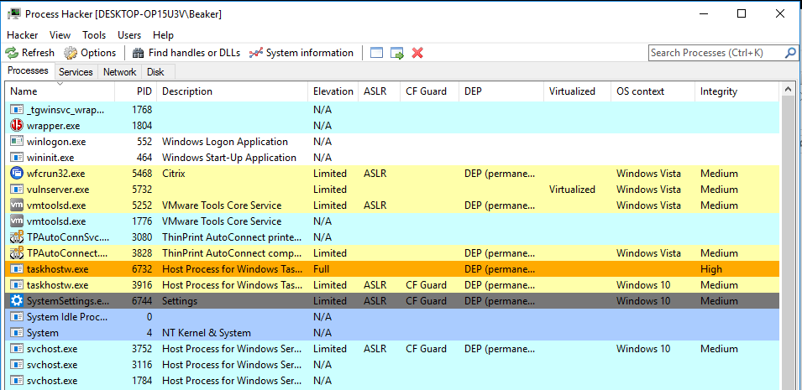
Which Mitigation Controls Are Active?
Process Hacker (processhacker.sourceforge.net)

Slide 49

Mitigation Bypass Techniques? Sure
It’s a continuous measure-countermeasure game but keeping up reduces exposure while increasing the cost for offense.

Slide 50
Forensics / Incident Response Example
A machine on your network is behaving oddly and a service or two seem to have crashed recently. It may have been compromised but your network has full packet capture. From a PCAP file can you:
Identify the service or application exploited
Identify the IP session containing the exploit (IP’s and ports)
If the attacker was successful in remote code execution, what did they do?
Can you extract their exploit and the shellcode for further analysis from the PCAP file (this example is non-trivial)?

Slide 51
Additional Resources
https://trailofbits.github.io/ctf/exploits/README.html
https://www.corelan.be/index.php/articles/
https://www.exploit-db.com/
https://samsclass.info/127/proj/vuln-server.htm

Slide 52
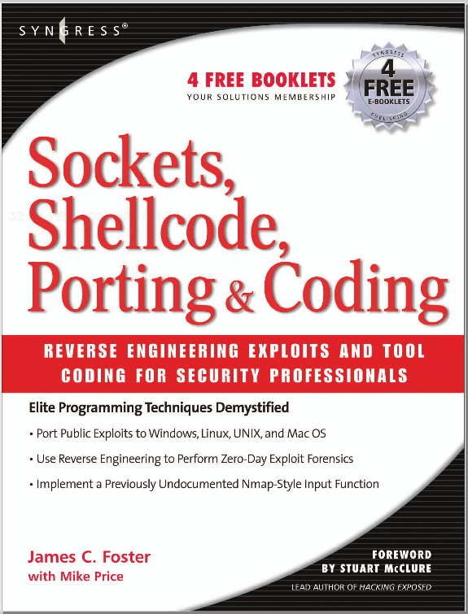


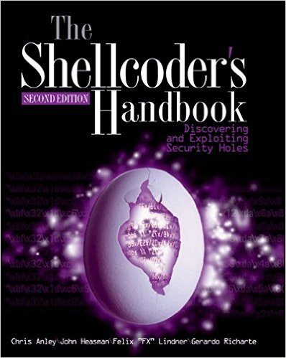

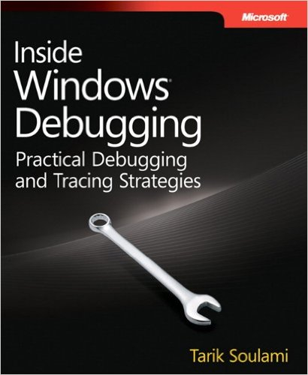
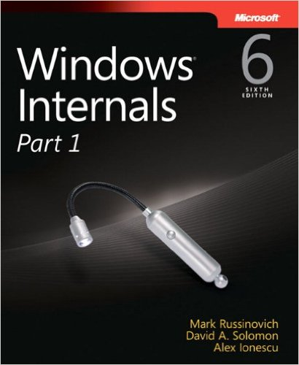
Books

Slide 53
Some gdb tips
(gdb) set follow-fork-mode child
(gdb) set disassembly-flavor intel
(gdb) r
starting program: /root/DEFCON813/SGNET/sgstatd
Server started. . .
^C
(gdb) i r
(gdb) backtrace

Slide 54
